Slide 1
Temporal evolution of interior carbon stocks in South Georgia
Evelyn Byer
University of Southampton
MSc Oceanography
September 4, 2018

Slide 2
Overview
Biological carbon pump, COMICS & South Georgia
Aims
Platforms, sensors & optical spikes
Temporal evolution of carbon
Conclusion & broader impacts
Notes:
Simplify and shorten <40 s

Slide 3
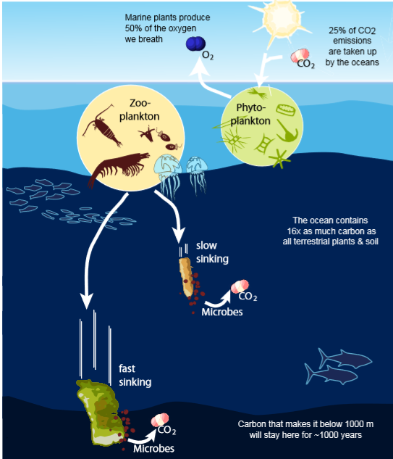
Biological carbon pump
Notes:
The ocean can act as a sink of carbon dioxide from the atmosphere through complex processes in which marine organisms remove CO₂ from the surface ocean and transport carbon to the deep ocean as particulate organic carbon (POC). Once it is exported to depth, carbon can stay trapped for hundreds or thousands of years, effectively hiding from the atmosphere. This process mitigates climate change and is linked with the cycling of elements through the ocean. However, it is difficult to measure POC in high spatial and temporal resolution and we don’t fully understand processes in the mesopelagic.

Slide 4
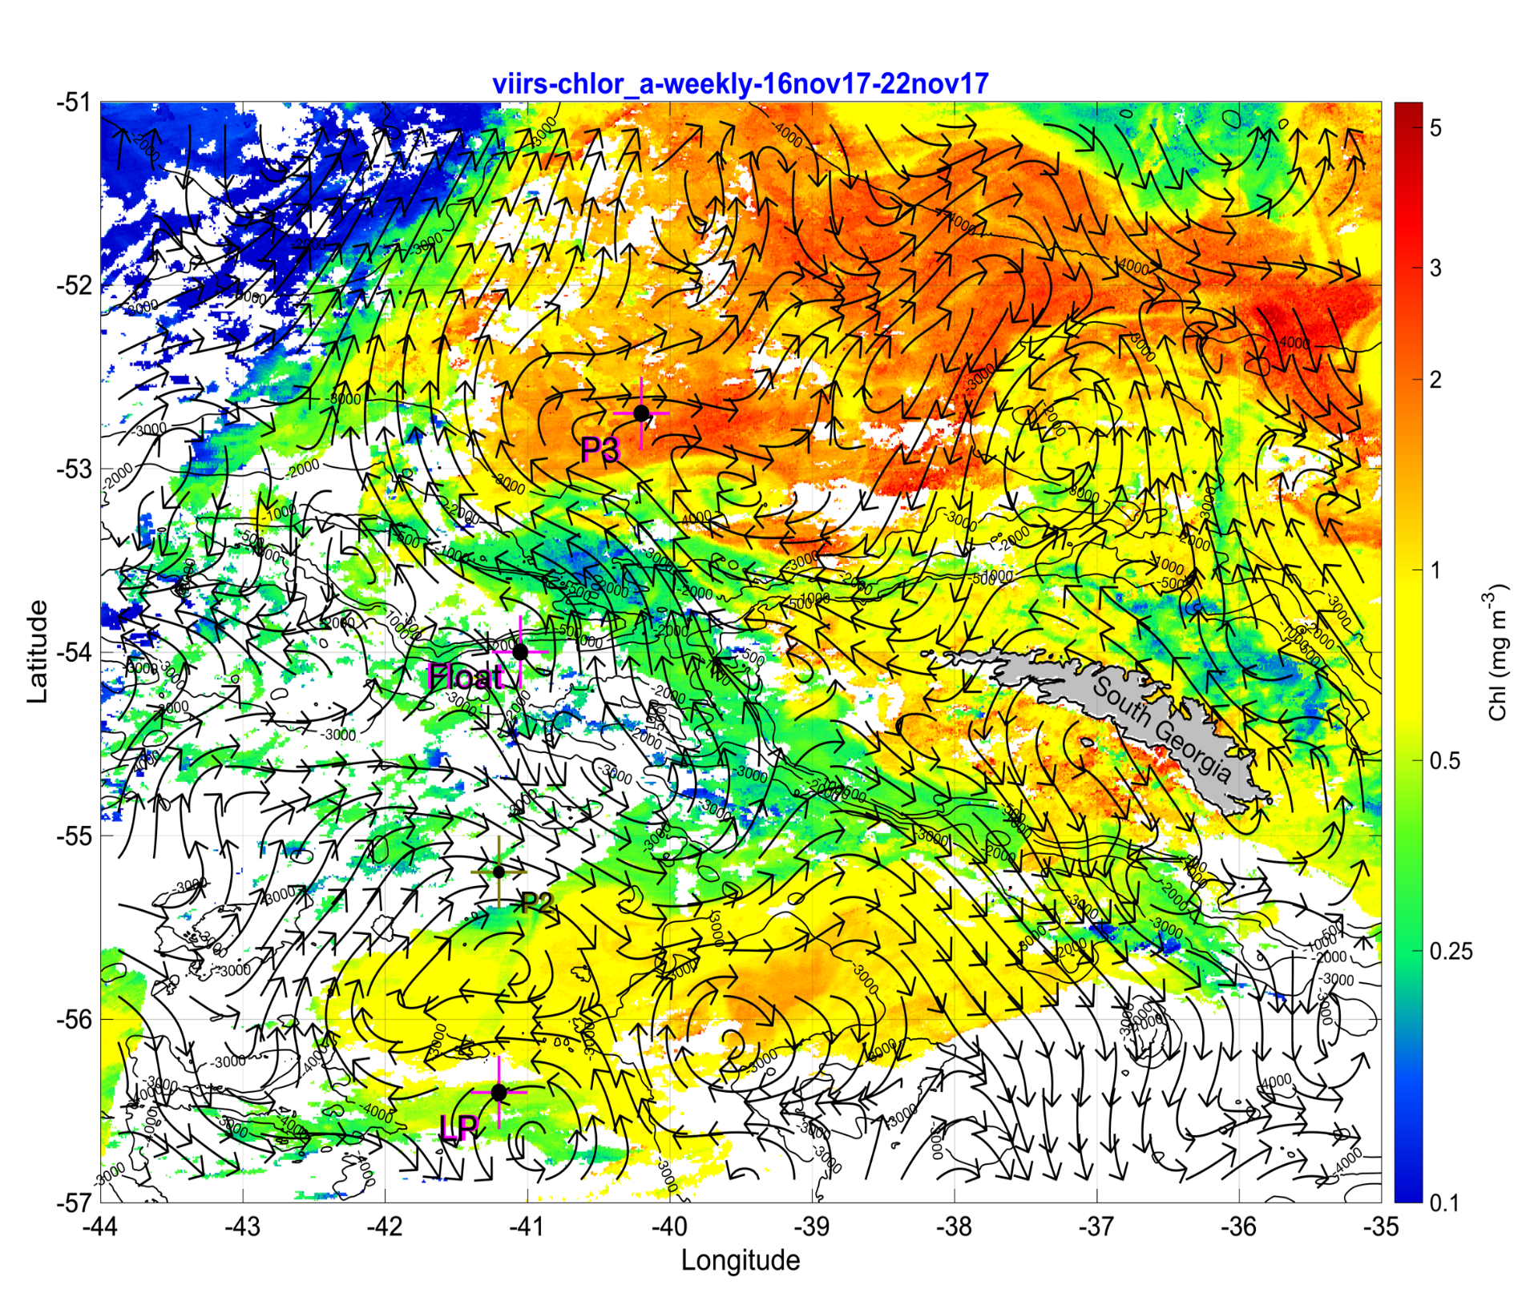

Introduction
COMICS cruise: Controls over Ocean Mesopelagic Interior Carbon Storage.
Bloom to the northwest of South Georgia one of the longest in the world.
Notes:
Go over graph
Three visits to P3 -> P3A P3B P3C
Figure: Sea Surface Temperature (SST) from MWIR with mean geostrophic currents overlaid.
Here, a project is proposed that uses optical data collected on COMICS cruise to determine the variability of POC and in South Georgia.

Slide 5
Aims
Objective: use high resolution optical data collected on COMICS cruise to determine the temporal evolution of particulate organic carbon (POC) in South Georgia.

Slide 6
Aims
Objective: use high resolution optical data collected on COMICS cruise to determine the temporal evolution of particulate organic carbon (POC) in South Georgia.
Describe the temporal evolution of chlorophyll a and POC at station P3.
Quantify particle attenuation and flux below the surface layer using optical spike data.

Slide 7
Aims
Objective: use high resolution optical data collected on COMICS cruise to determine the temporal evolution of particulate organic carbon (POC) in South Georgia.
Describe the temporal evolution of chlorophyll a and POC at station P3.
Quantify particle attenuation and flux below the surface layer using optical spike data.
This is the first time high-resolution optical backscatter from ship-based measurements have been used to estimate POC flux in South Georgia.

Slide 8
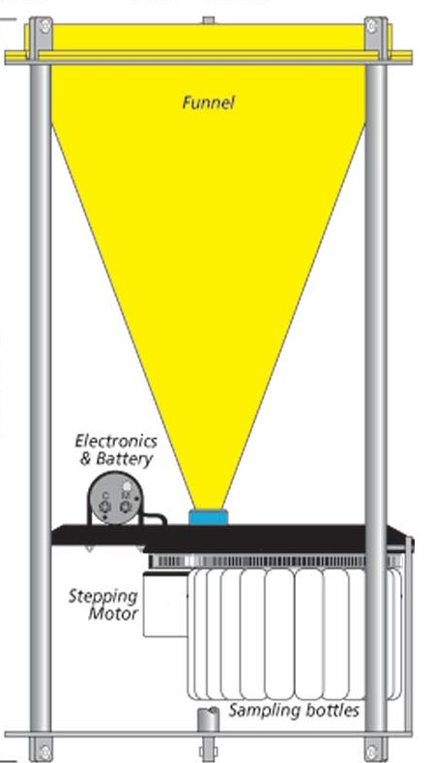
Traditional flux instruments
Sediment traps
Funnel design uses a large collection area to sample particle flux.
In deep water, it can take a long time to collect enough sediment for a sample.
Image: Oceanus magazine, WHOI

Slide 9
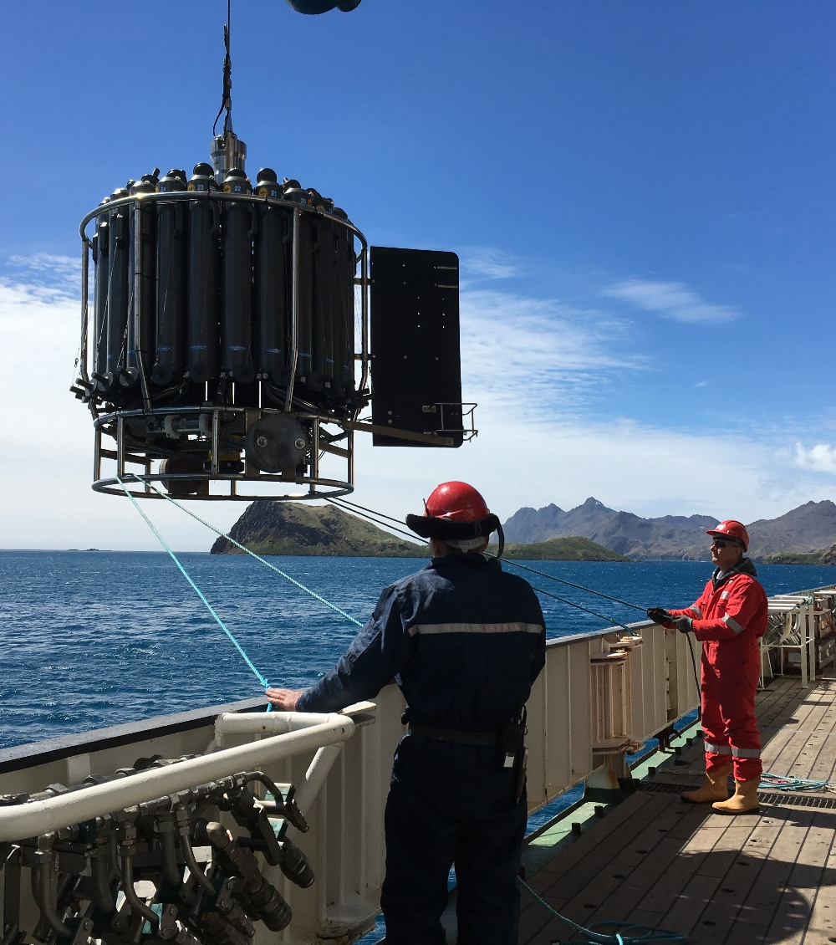
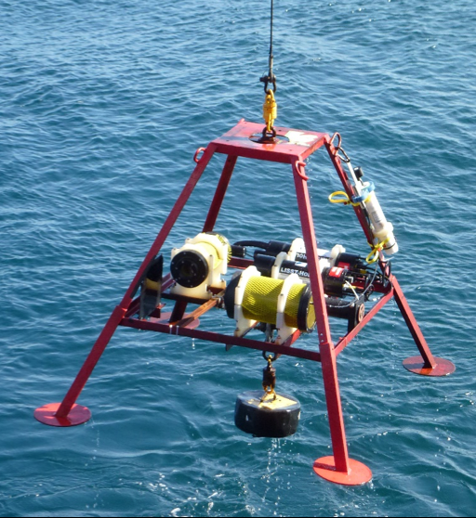
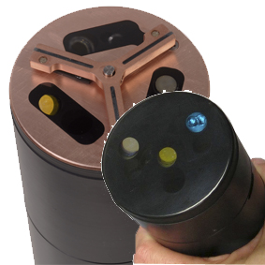
Platforms & sensors
CTD Rosette
Red Camera Frame (RCF)
WetLabs ECO Triplet
Fluorescence and backscatter
Notes:
Different speeds – affects optical data, so split analyses
All ship-based
ECO puck on profiles of both
ECO stands for “Environmental Characterization Optics”
Add number of profiles for each

Slide 10
Step 1: I used a several simplifying
assumptions in the model
Optical data - Large particles cause “spikes”
Chlorophyll fluorescence or backscatter
Time

Slide 11
Step 1: I used a several simplifying
assumptions in the model
Large particles cause “spikes”
Chlorophyll fluorescence or backscatter
Median Filter
Time

Slide 12
Step 1: I used a several simplifying
assumptions in the model
Large particles cause “spikes”
Large particle
signal
Chlorophyll fluorescence or backscatter
Small particle
signal
Time

Slide 13
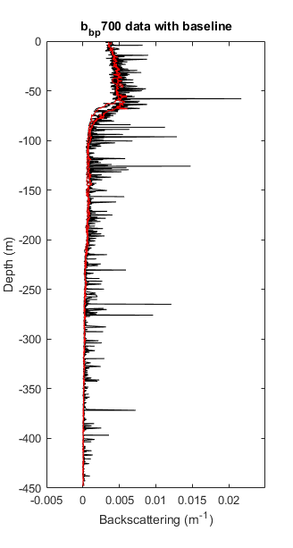
Optical proxies & spikes
Fluorescence → calibrate with bottle data (R²=0.97 & 0.96) → chlorophyll a concentration.
Backscatter (700 nm) → backscattering → (calibrate with conversion factor from literature) → POC concentration.
Baseline = background concentration
Spikes = larger particles and/or aggregates
Notes:
Explain profile well.
Particulate optical backscattering (b_{bp}) is sensitive to marine particles and is correlated to the concentration of particulate organic carbon (POC) (size range 0.2–20 μm )
conversion factor of BBP to POC from literature (Nathan’s paper). Justify -> there are samples of POC taken during cruise but they haven’t been analysed.
Baseline found by smoothing optical data – applying a running median .
Mention that chl calibration had good fit.

Slide 14
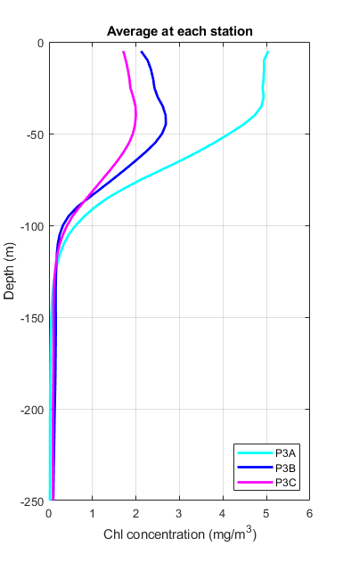
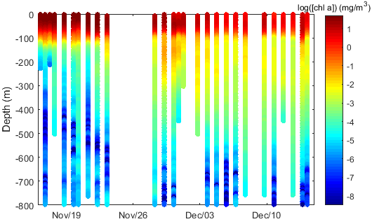
Phytoplankton dynamics
P3A
P3B
P3C
Notes:
Explain graph
Log scale – connect mean profiles and scatter
Ultimately phytoplankton drives export
Chl data from all platforms
Describe phytoplankton dynamics
Surface concentration
‘flux’ in baseline below WW in P3B

Slide 15
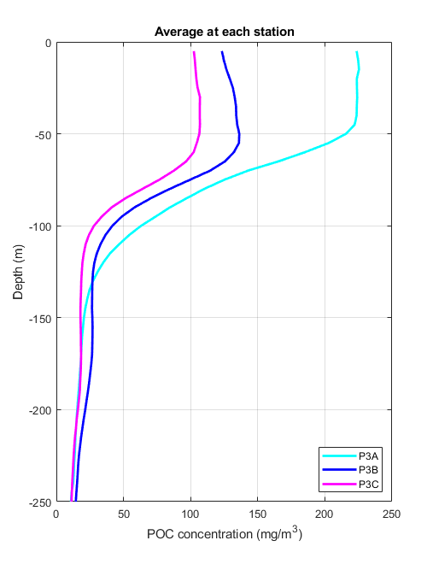
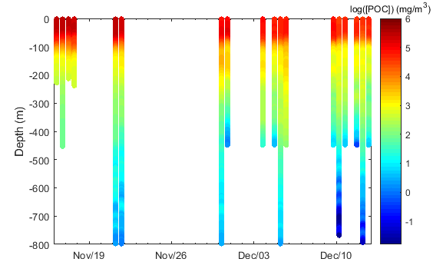
POC dynamics
P3A
P3B
P3C
Notes:
Phytoplankton ->POC
Just data from ECO puck
Link back to physical variables
Transition to spikes – this is baseline, spikes were left over which we will focus on next

Slide 16
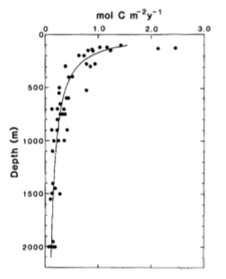
Martin curve
The best fit to observed decrease in particle flux vs. depth (Martin Curve):
F_{z}=F₀ (z/z₀) ^{−b}
Large b-value = high attenuation and shallow remineralization.
Image: Martin et al., 1987

Slide 17
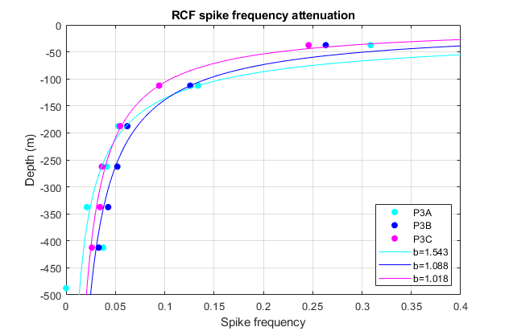
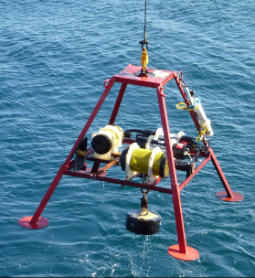
Temporal evolution of particle attenuation
spike frequency_{z} = spike frequency₀*(z/z₀)^{-b}
Spike frequency reflects concentrations of larger particles.
b-values from RCF are not significantly different during P3A, P3B or P3C.
Notes:
Used looked at RCF and CTD separately because different speeds can affect spikes, chose RCF because more casts for temporal.
First bin not included in attenuation because of uncoupling between spike signal and particles at the surface.
RCF all combined= b=1.29;

Slide 18
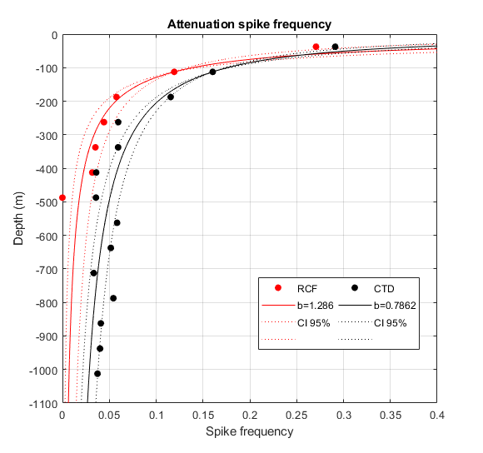

Particle attenuation
b-values from RCF and CTD are statistically different.
Can not compare optical spike data from different platforms and speed.
≠
Notes:
Here spikes represent concentration of bigger particles.

Slide 19
POC flux
Flux_{z} = mean spike height x spike frequency_{z} x POC-b_{bp}700-ratio x sinking rate
370000 mg POC m⁻²
100 m d⁻¹
Flux₂₀₀ = RCF: ~210 mg m⁻² d⁻¹
CTD: ~193 mg m⁻² d⁻¹
Reasonable values when compared to the literature
POC-b_{bp}700-ratio: Cetinic et al., 2012
Sinking rate: Cavan et al., 2016

Slide 20
Conclusions
Describe the temporal evolution of chlorophyll a and POC at station P3.
Quantify particle attenuation and flux below the surface layer using optical spike data.
Notes:
present the key results of your project work and their interpretation, in the context of the question that you defined.
Notes for 1. Likely caused by low-light acclimated phytoplankton+ MLD shallowing or nutrient-depletion in the surface (silicate…iron).
2. When compared to values from the literature, flux values are not unreasonable. B-values?

Slide 21
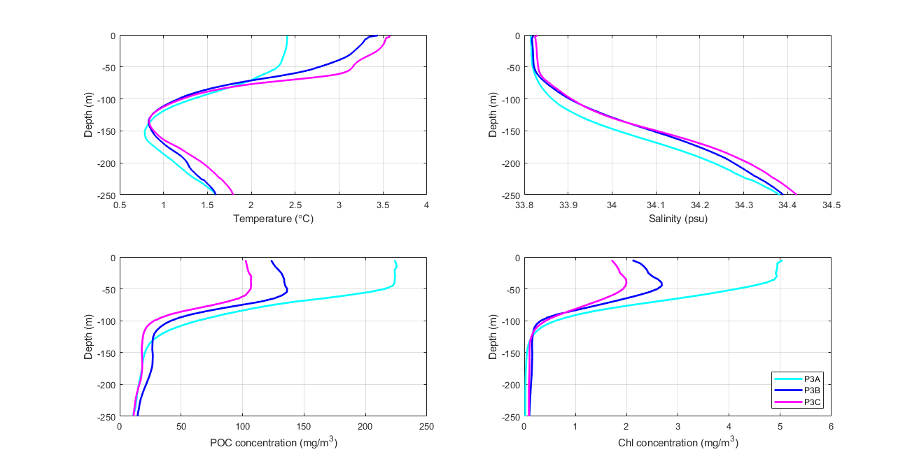
Conclusions
Describe the temporal evolution of chlorophyll a and POC at station P3.
Concentration of chlorophyll a and POC decrease in the surface ocean from mid-November to mid-December. A signal of a flux event can be seen under the surface layer in both chlorophyll a and POC during P3B and P3C.
Quantify particle attenuation and flux below the surface ocean using optical spike data.
POC flux was estimated to be ~210 mg m⁻² d⁻¹ from the RCF and ~193 mg m⁻² d⁻¹ from the CTD at 200 m. For the RCF and CTD, b=1.29 and b=0.79 respectively.
Notes:
present the key results of your project work and their interpretation, in the context of the question that you defined.
Notes for 1. Likely caused by low-light acclimated phytoplankton+ MLD shallowing or nutrient-depletion in the surface (silicate…iron).
2. When compared to values from the literature, flux values are not unreasonable. B-values?

Slide 22

Conclusions
Quantify particle attenuation and flux below the surface ocean using optical spike data.
POC flux was estimated to be ~210 mg m⁻² d⁻¹ from the RCF and ~193 mg m⁻² d⁻¹ from the CTD at 200 m. For b-values for the RCF and CTD were significantly different from one another (b=1.29 and b=0.79 respectively). Values compare well with the literature.
Notes:
present the key results of your project work and their interpretation, in the context of the question that you defined.
Notes for 1. Likely caused by low-light acclimated phytoplankton+ MLD shallowing or nutrient-depletion in the surface (silicate…iron).
2. When compared to values from the literature, flux values are not unreasonable. B-values?

Slide 23
Broader impacts
Optical spike data may not be comparable across different platforms and/or different speeds in future analyses, which is specifically useful for COMICS.
Optical flux measurements are an advancement over traditional flux measurements in quantifying temporal evolution of interior carbon stocks and mesopelagic processes.

Slide 24
Questions?

Slide 25
Oceanographic setting
Notes:
Connect temperature and salinity to chlorophyll a and POC
Temperature increased, salinity variability was relatively low, POC and chl concentration decreased in upper 50 m over time, can see elevated baseline in P3B and P3C under the winter water.

Slide 26
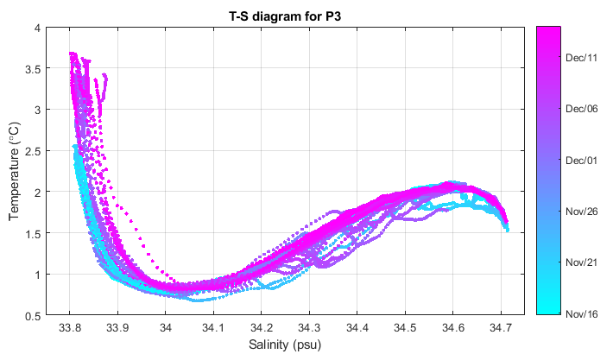
Oceanographic setting
Notes:
Warming in surface layer during duration of measurements.
Winter Water layer (cold and low salinity)
Salinity not as variable as temperature.
Introduce station P3A, B, C

Slide 27
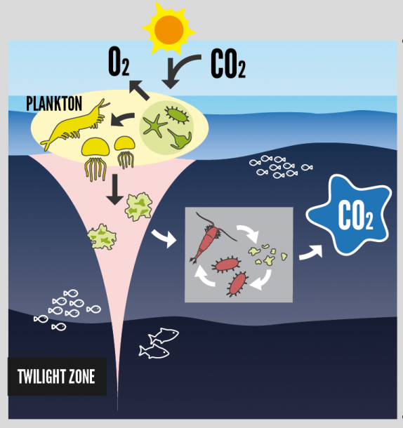
Biological carbon pump
Notes:
The ocean can act as a sink of carbon dioxide from the atmosphere through complex processes in which marine organisms remove CO₂ from the surface ocean and transport carbon to the deep ocean as particulate organic carbon (POC). Once it is exported to depth, carbon can stay trapped for hundreds or thousands of years, effectively hiding from the atmosphere. This process mitigates climate change and is linked with the cycling of elements through the ocean. However, it is difficult to measure POC in high spatial and temporal resolution.

Slide 28
Optical proxies & spikes
Fluorescence -> calibrate with bottle data (R²=0.97 & 0.96)-> chlorophyll a concentration.
Backscatter (700 nm)-> backscattering -> (calibrate with conversion factor from literature) -> POC.
Baseline = background concentration
Spikes = larger particles and/or aggregates
Notes:
Explain profile well.
Particulate optical backscattering (b_{bp}) is sensitive to marine particles and is correlated to the concentration of particulate organic carbon (POC) (size range 0.2–20 μm )
conversion factor of BBP to POC from literature (Nathan’s paper). Justify -> there are samples of POC taken during cruise but they haven’t been analysed.
Baseline found by smoothing optical data – applying a running median .
Mention that chl calibration had good fit.

